Slide 1

Docker Training – Day 2
Docker Swarm

Slide 2
Contents
1.
Docker Swarm
2.
Docker Services
3.
Docker Stacks
4.
Built-in Load Balancing
5.
Lab Objectives
6.
Monitoring & Troubleshooting
7.
Swarm Recap
8.
Questions
9.
Resources

Slide 3
01
Docker Swarm

Slide 4
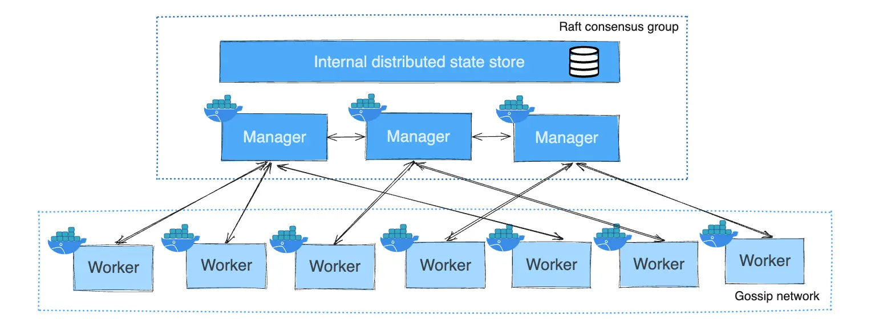
Docker Swarm Architecture

Slide 5
What is Docker Swarm?
Native Docker orchestration tool
Built- in clustering, scaling, and scheduling
Simple to set up and tightly integrated with Docker

Slide 6
Swarm Mode Overview
Initialize
Add workers
docker swarm init
docker swarm join Enables featuresHigh availability, Service discovery, Load balancing

Slide 7
Swarm Components
Manager Node
Worker Node
01
02
Orchestrates cluster, maintains state
Executes containers/tasks
Services
Tasks
03
04
Long- running container definitions
Instances of containers

Slide 8
02
Docker Services

Slide 9
Creating and Managing Services
Rolling updates
Scale replicas
Create a service
- -update- * flags
docker service scale
docker service create

Slide 10

Sample: Creating a Service
Example command
docker service create \
- -name web \
- -replicas 3 \
- p 80:80 nginx

Slide 11
03
Docker Stacks

Slide 12
Define and Deploy Stacks
Define multi-container apps
Deploy stacks
by creating docker- compose.yml
docker stack deploy Stacks run on Swarm clusters only

Slide 13
Compose vs Stack
Compose – Local Docker only
Stack: docker stack deploy
Differences
Stack – Docker Swarm
Compose for Dev
Composedocker- compose
Stack for Production

Slide 14
04
Built-in Load Balancing

Slide 15

Load Balancing Types
O1
Routing Mesh (default)
O2
VIP Load Balancer
O3
Host Mode (custom load balancers like HAProxy)

Slide 16
Swarm routing mesh
All nodes can route to any service
Exposes service on published port (ingress)
DNS- based service discovery
Features

Slide 17
Load Balancing Example
Example workflow
Incoming traffic → Any node → Routed to available replica
Overlay network ensures container communication across nodes

Slide 18
05
Lab Objectives

Slide 19
Setup and Deployment
Objectives
Setup Swarm cluster (1 manager, 2 workers)
Deploy a scalable service
Deploy stack from docker- compose.yml
Simulate a node failure

Slide 20
Lab Commands Quick Reference
docker swarm init
docker swarm join - -token ...
Command List
docker service create - -name nginx - p 80:80 nginx
docker stack deploy - c docker- compose.yml mystack

Slide 21
06
Monitoring & Troubleshooting

Slide 22
Monitoring Nodes and Services
Node status
docker node ls
Task placement
docker service ps <service>
Stack status
docker stack ls docker stack ps <stack>

Slide 23
07
Swarm Recap

Slide 24

Summary
Key points
Simple orchestration tool built into Docker
Good for small to medium scale production setups
Services, Stacks, Load Balancing covered

Slide 25
08
Questions

Slide 26
Questions
Container vs Service
Scaling and Fault Tolerance
What is the difference between a container and a service?
How does Swarm handle scaling and fault tolerance?
Manager Node Failure
Large-scale Production
What happens when a manager node fails?
Can Swarm be used for large- scale production?

Slide 27
Questions & Answers
Container vs Service
Scaling and Fault Tolerance
What is the difference between a container and a service? - A container is a single running instance of an image. - A service is a higher-level abstraction in Swarm that manages multiple container replicas, scaling, and updates.
How does Swarm handle scaling and fault tolerance? - Swarm scales by increasing service replicas. - It ensures fault tolerance by rescheduling tasks if a node or container fails.
Manager Node Failure
Large-scale Production
What happens when a manager node fails? - If it’s a non-leader, no impact. - If it’s the leader, a new leader is auto-elected from remaining managers.
Can Swarm be used for large- scale production? - Yes, for small to mid-sized setups. - For very large-scale systems, Kubernetes is preferred due to richer features and ecosystem.

Slide 28
09
Resources

Slide 29
Additional Resources
01
02
Docker Docs
Play with Docker
https://docs.docker.com/engine/swarm/
https://labs.play- with- docker.com/

Slide 30
Thanks
Karthikeyan Vaiyapuri

